Slide 1
Channels and Campaigns-Interaction Studio
Ganesh

Slide 2
Web Campaign
Web Campaign Types
Banner With Call-To-Action
Einstein Product Recommendation
Exit Intent Pop-Up
Rule Based
A/B Testing
Sign-Up-Pop
Web Campaign Components
Server side
Handler Bar
CSS style
Client Side

Slide 3
Web Campaign
Build Web Campaigns from Global Templates
Clone Global Templates to use in Web Campaigns:
Build 3 campaigns for your client, NTO:
A personalized Homepage Hero Banner
A product recommendations campaign
An Email capture popup that will A/B test diﬀerent messages

Slide 4
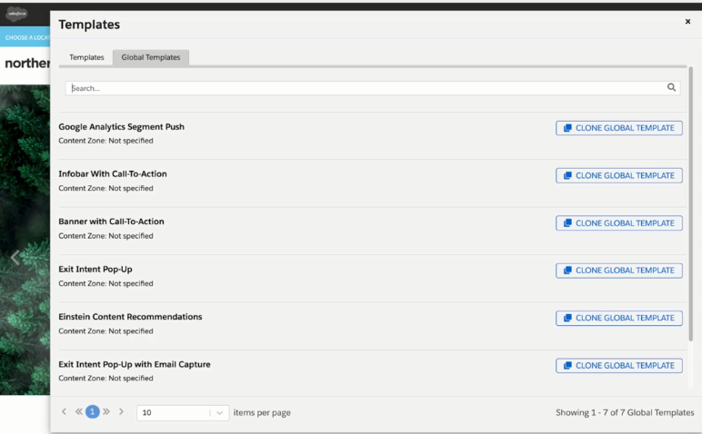
Global Template: Global templates are highly customized for individually

Slide 5
Home page Banner with Call-To-Action
Home page Banner with Call-To-Action
Navigate to the Homepage of the Website.
Name: Homepage Banner with Call-To-Action.
Template Settings(bottom left nav): Select the “home_hero” content zone.
Save & Publish, Close.

Slide 6
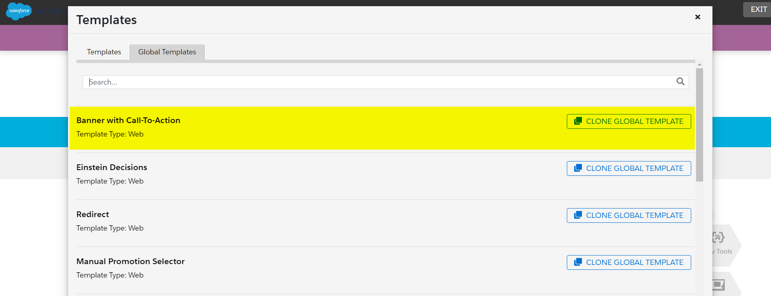
Create a new web template by cloning a global web template Banner with Call to Action and renaming it (Banner with CTA).

Slide 7
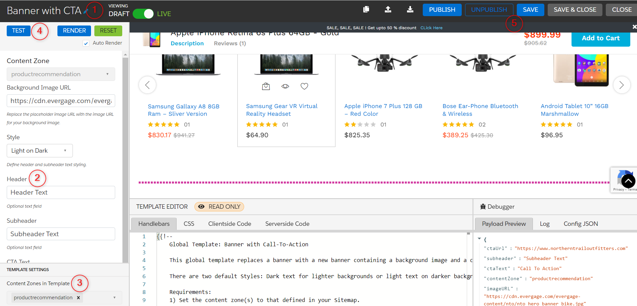
Provide the content or heading to the banner. Select a Content Zone to display a banner in the defined area of the webpage. We can test the web template which displays the banner in the defined area of the webpage. Save the web template and then publish it.

Slide 8
Einstein Product Recommendations
Einstein Product Recommendations
Navigate to a Product Detail Page of the Website
Name: PDP Product Recommendations
Template Settings: Select the “product_detail_recs_row_1” content zone
Save & Publish, Close

Slide 9
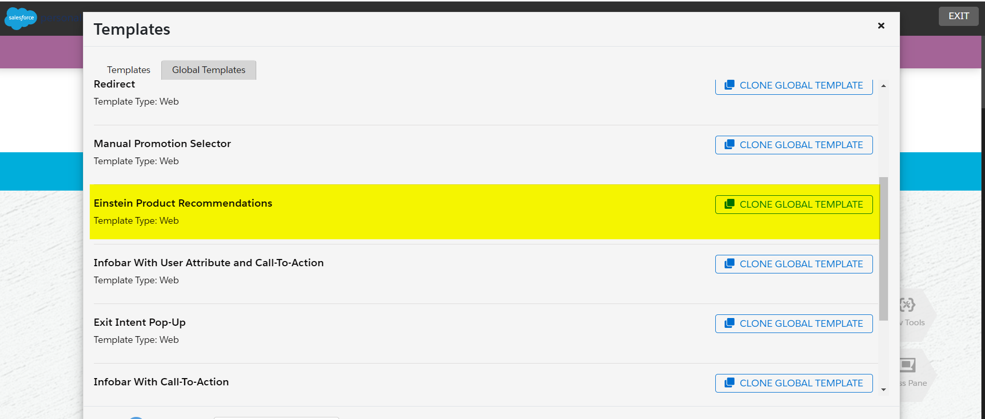
Create a new web template cloning a global web template Einstein Product Recommendations and rename (Product Recommendation) it.

Slide 10
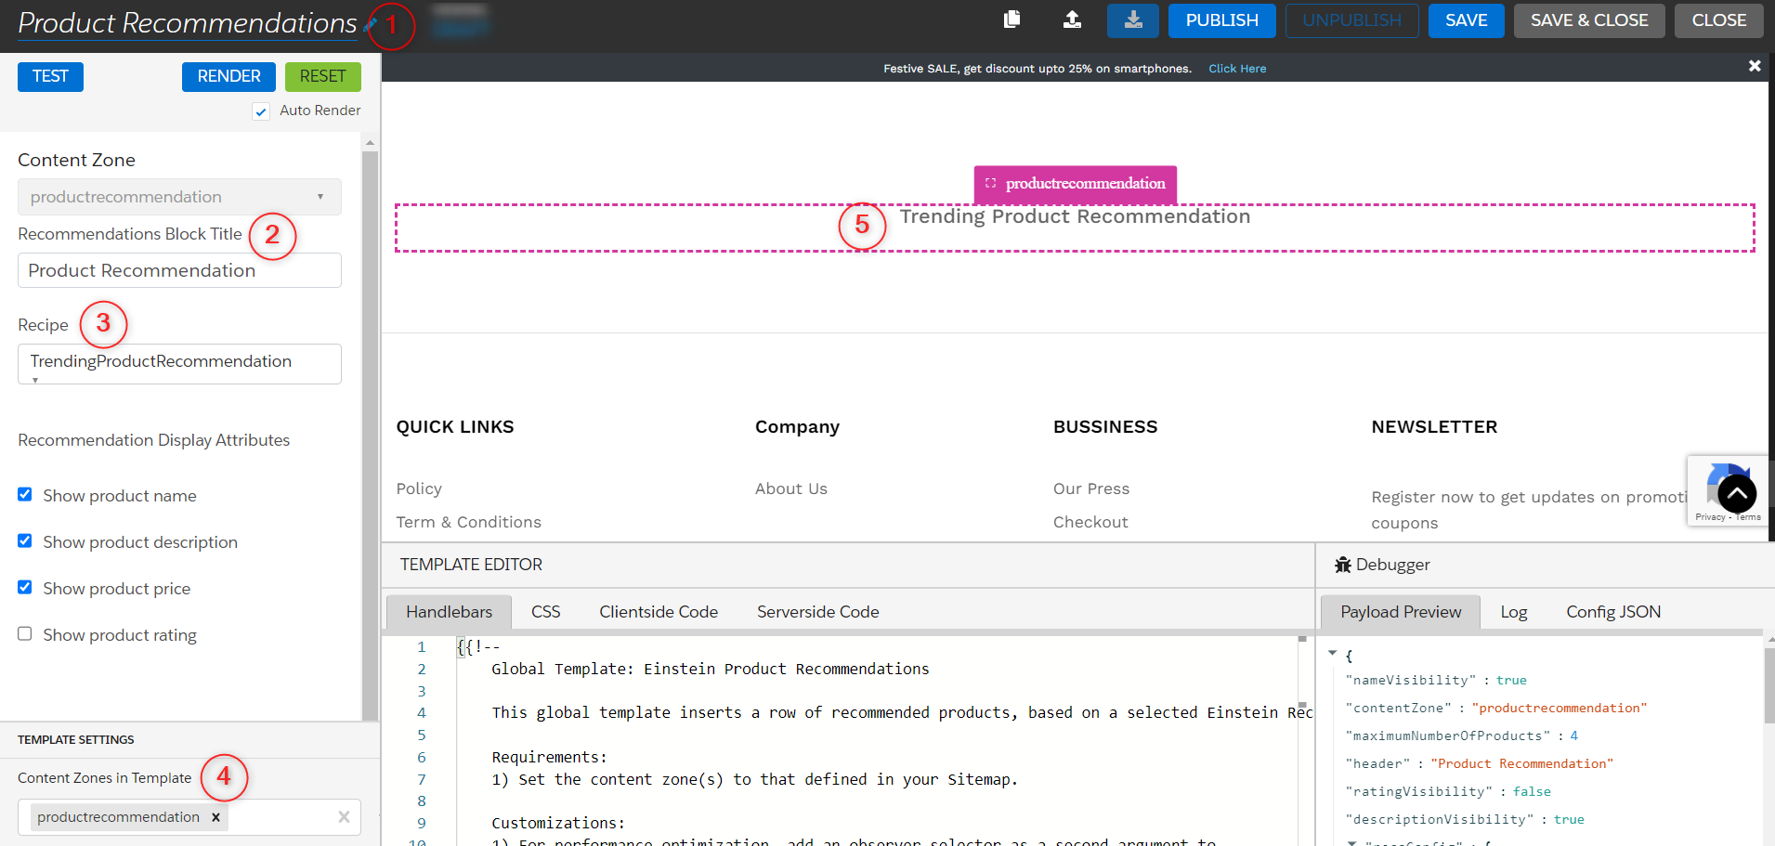
Provide the recommendation block title. Select an Einstein Recipe to represent each customer product recommendation from various channels which we have configured in Einstein Recipe. Select a Content Zone to display a product recommendation block on a webpage. As you can see the block is displayed on the defined area of the webpage. Don’t forget to save and then publish it.

Slide 11
Exit Intent Pop-Up with Email Capture
Navigate to the Homepage of the Website
Name: Exit Intent with Email Capture
Template Settings: Select the “home_popup” content zone
Save & Publish, Close
Create a web template using the Global template- Exit Intent Pop-up with Email Capture. Click on Clone Global Template.

Slide 12
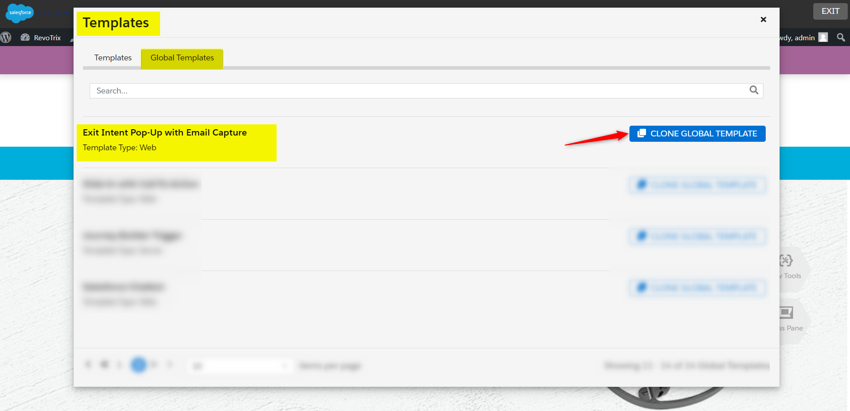

Slide 13
Follow the following steps to configure the cloned global web template:
Rename the template.
Select the content zones (declared on the Sitemap) that define an area to display the popup.
We can edit and modify the template design using the template editor. Adding Open Time Campaign HTML code in it to display the cart details of the user.
Click on Save to save the web template.

Slide 14
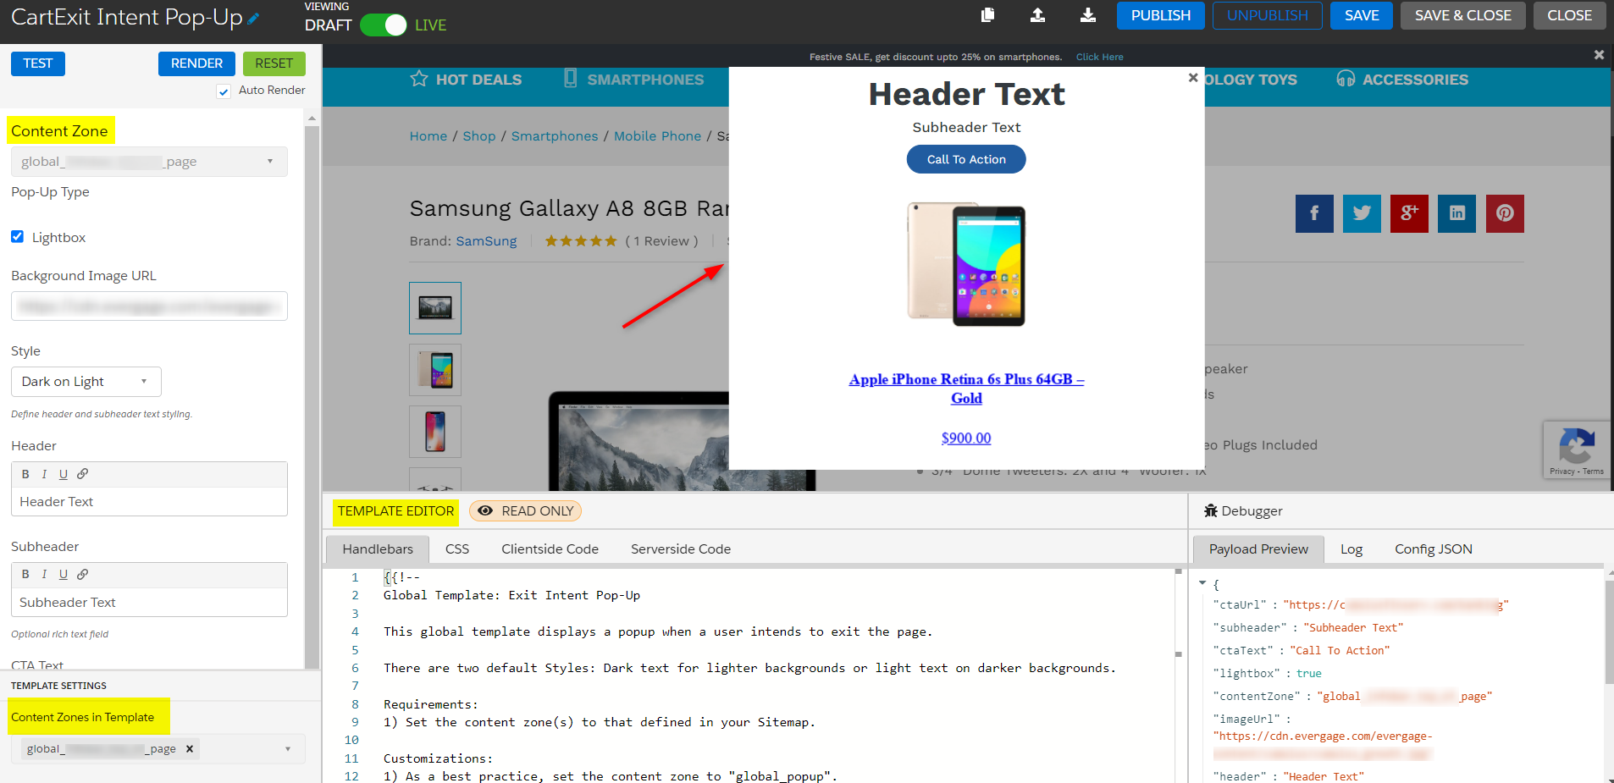

Slide 15
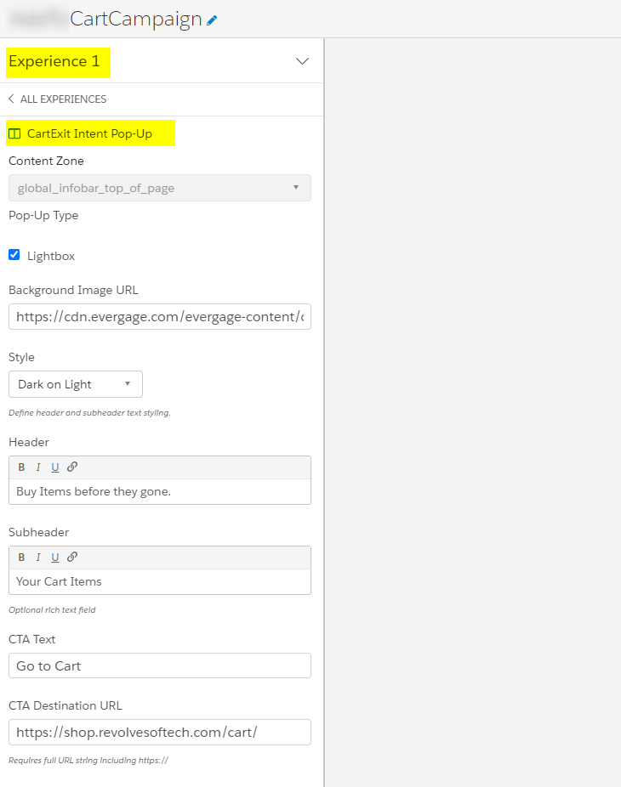
Web Campaigns Create a Web Campaign and use this template in the Web Campaign Experiences. Configure this template, providing headings and CTA button links.

Slide 16
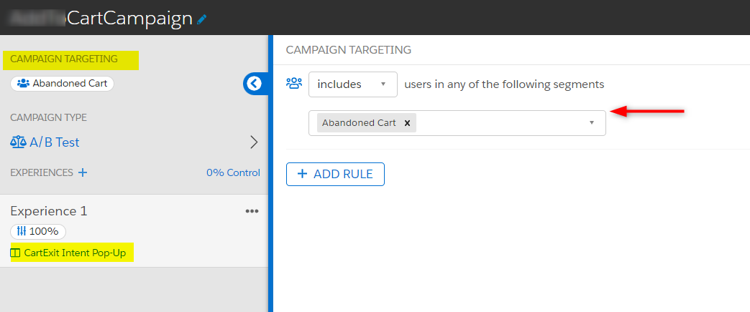
Add a rule in Campaign Targeting for users who are in Abandoned Cart User Segment to show the campaign on the web page

Slide 17
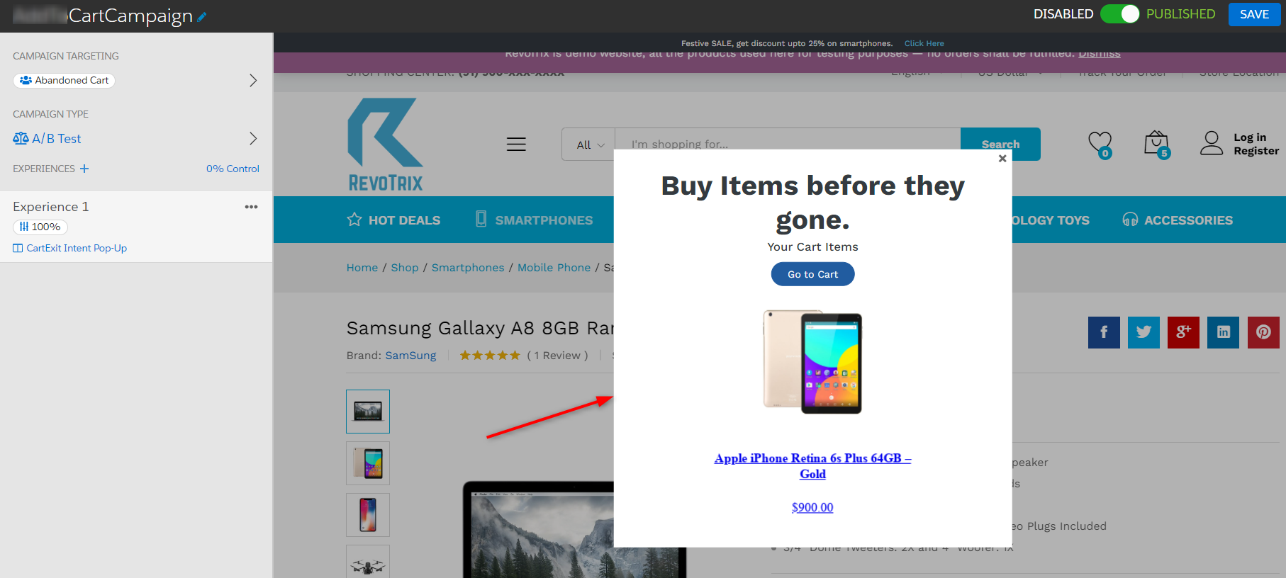
Save and publish it.

Slide 18
Open Time Email Campaigns
Ganesh

Slide 19
Open Time Email Campaigns
Marketing Cloud Personalization's Open Time Email (OTE) Campaigns and Item Templates enable you to deliver content and product recommendations personalized at the time a recipient opens an email.
Marketing Cloud Personalization uses machine learning to target and deliver personalized content and email recommendations. It helps convert static content to open-time personalized content.
Open time email template is a combination of image, name, brand, price, call to action into single template.
A block of email HTML code that can be placed directly into a greater html template to create a personalized experience in any emails.
Experience is promotions and Actions.
Dynamic emails based on content zones.

Slide 20
Open-time email campaigns are used to deliver personalized content and product recommendations each time a recipient opens an email.
Using existing email campaigns that you send from the marketingcloud, Open Time Email campaigns deliver real-time personalized content to each member of your subscriber list.
For building this campaign make sure you have Einstein Recipe that recommends personalized content and products to a particular user. The following steps are configured to use Open Time Email Campaigns:
Steps to Create an Open Time Item Template:
Create a new open-time item template.
Design the template and write HTML content.
You can preview the design on the right and then Save it.

Slide 21
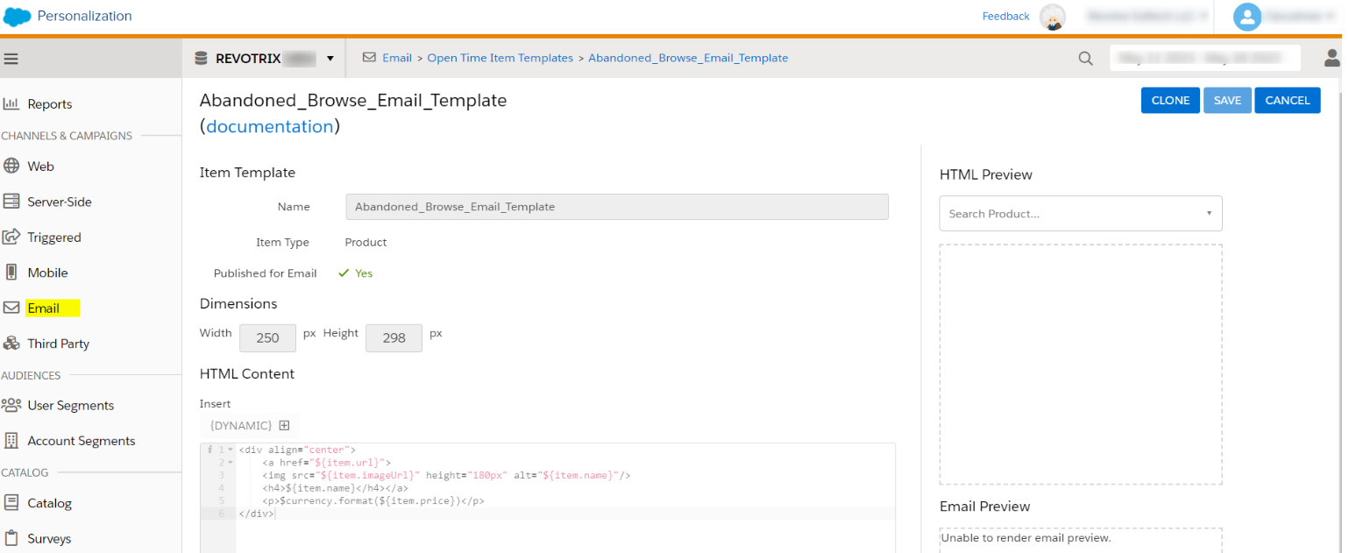

Slide 22
Steps to Create an Open time Campaign:
Create a new open-time campaign.
Configure with a block name(Block1).
Select created open-time template and configure it.
Select an abandoned cart Einstein Recipe, which is created in earlier steps.
Set excludes and includes products in the exclusions
Save and simulate it.

Slide 23
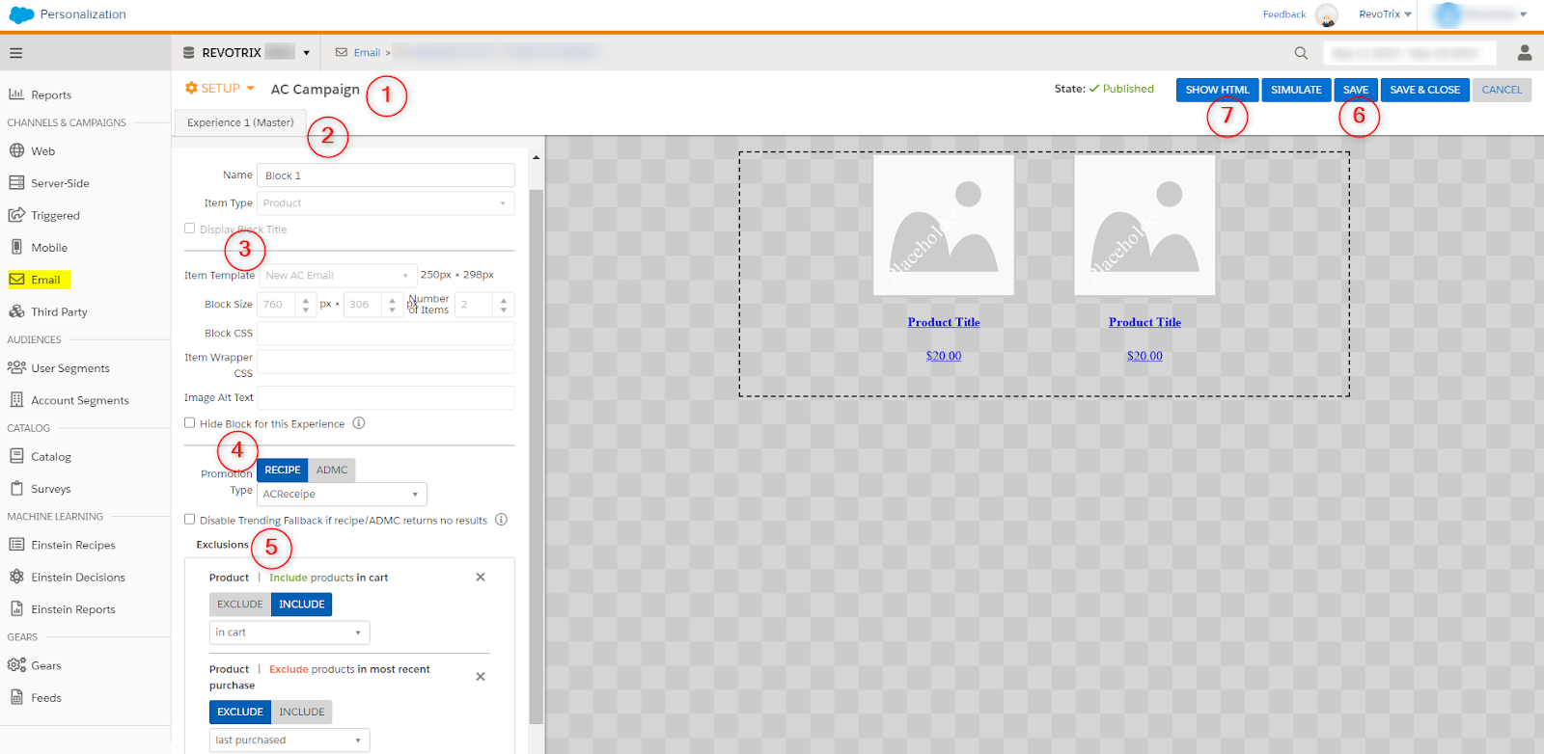

Slide 24
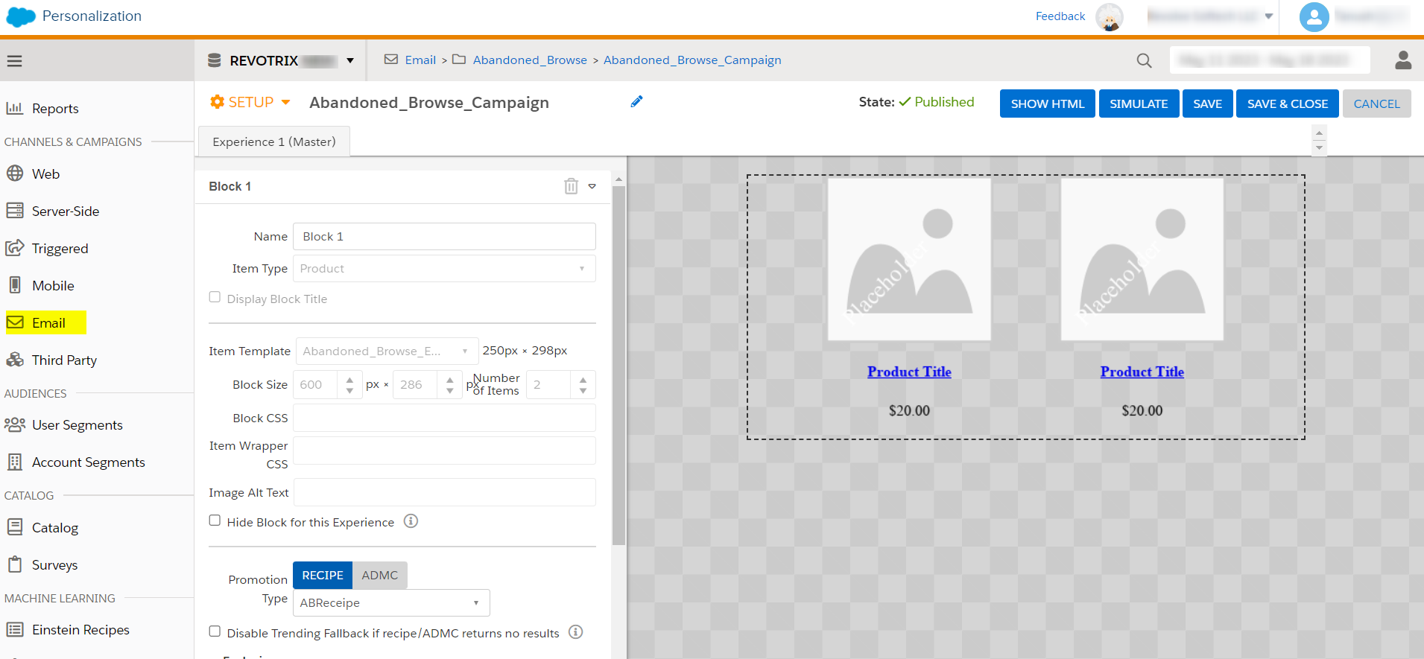

Slide 25
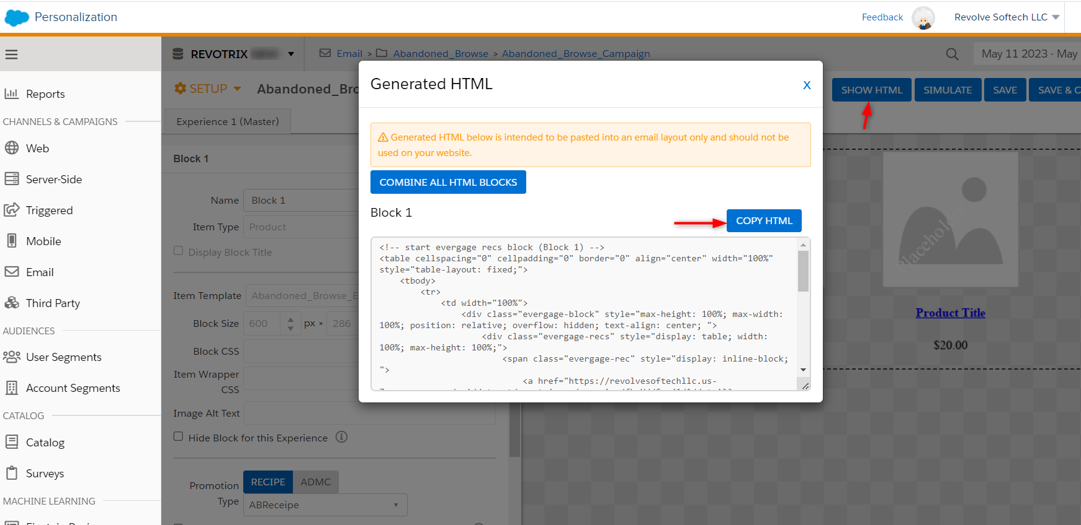
Copy the generated HTML code and paste it into a template-based Email in Marketing Cloud Content Builder.

